Slide 1
Midterm Presentation - P4 Accuracy of Approximate Circuits
Fabian Garber, Simon Howind, Kagan Özten, Martin Resetarits, Peter Traunmüller
Notes:
Hallo everybody and welcome to our presentation. We are going to present the topic P4 Accuracy of Approximate Circuits

Slide 2
Introduction
Advantages of approximate computing
Energy-efficient
Less area
Less computing time
1/
Notes:
We would like to start with a small introduction about approximate computing and its advantages compared to conventional circuits.
According to multiple papers, it has shown to be one of the most promising energy-efficient paradigms and has therefore reached a lot of research attention.
Another advantage of the approximate circuits is that the hardware uses less space due to the reduced number of logic gates.
For the same reason it has a reduced delay time and produces faster results.

Slide 3
Designed architecture
Presenting our design
implementing two versions of Full-Adder (one exact and one approximate)
CIRCUIT DIAGRAMME hinzufügen und Unterschiede erklären mit Hilfe von Tabelle
1/
Notes:
Now adding to all the advantages, the question arises How do approximate circuits achieve all of those above mentioned advantages in our design?
As already mentioned, the amount of logic gates is reduced. For demonstration purposes, we are going to show you two different Full Adder designs. One exact and one approximate.

Slide 4
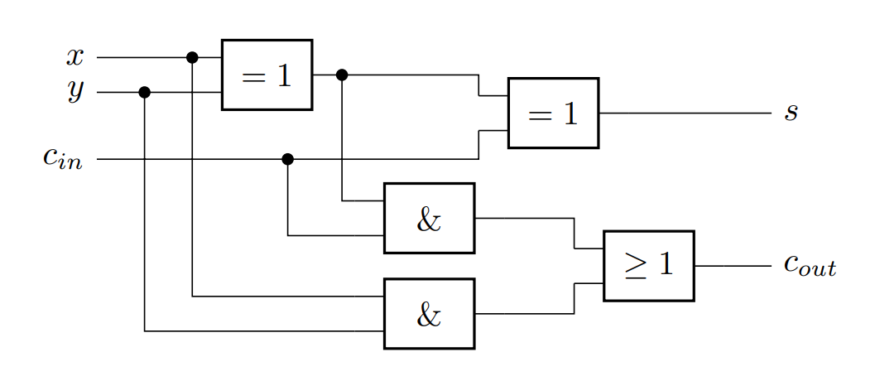
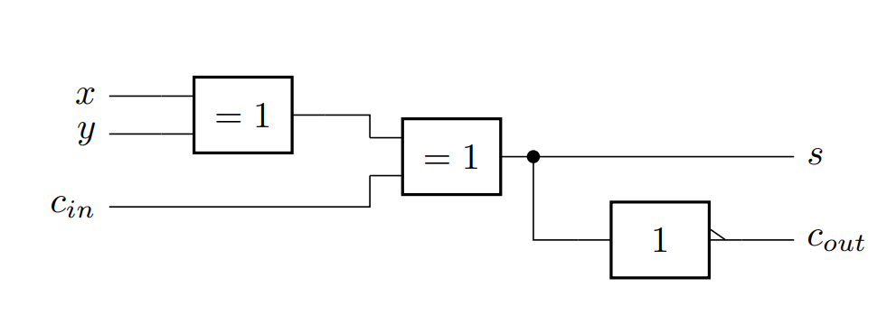
Circuit Designs
Conventional Full Adder Circuit Design
Approximate Full Adder Circuit Design as proposed in [source]
1/
Notes:
The first design is an exact adder and the second one is an approximate design taken from a paper.
As you can clearly see, the second one is „missing“ some logic gates.
To see what effect it has, we will take a look at the truth tables.

Slide 5
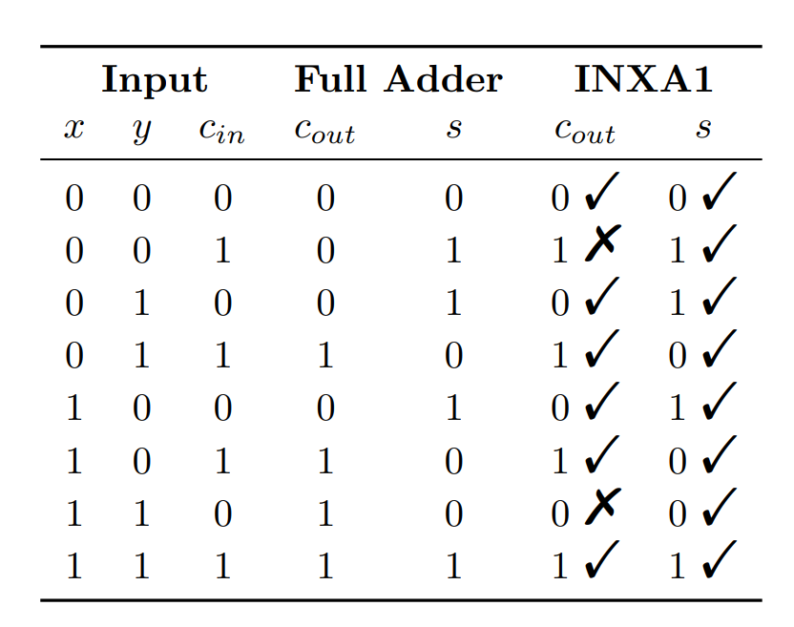
Truth Table
<Foliennummer>/
Notes:
As we can see the sum is always calculated correctly. However, deviations occur, when calculating the carry out. In this chart the tick marks show a correct result, and the crosses indicate a wrong bit. Therefore in 6 out of 8 cases, we are calculating the correct carry out.
This design will be implemented on an open-source processor.
Error can happen in MSB -> Error is more significant.

Slide 6
Error Analysis
For multi bit inputs, the error is not Hamming distance
Error must be interpreted as number
6/
Notes:
Vortragender Wechselt

Slide 7
Error Analysis
For multi bit inputs, the error is not Hamming distance
Error must be interpreted as number
EXACT
subtract and
absolute
Error
INXA1
7/

Slide 8
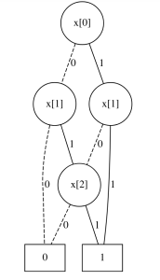
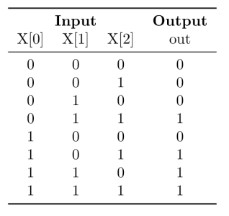
Binary Decision Diagram
8/
Notes:
As the system grows exponentially truth table analysis is not recommended anymore.
As solution to this problem we use a BDD
A BDD is an graph to represent the Boolean function. This graph enhances computer analysis

Slide 9
Current Status
VHDL code for full adder and INXA1 finished
Python code for Binary Decision Diagram for 1 bit analysis
First estimation of power consumption
9/

Slide 10
Future Plans
Time, Area and Power Analysis with VHDL TOOL
Adding functionality for generic N bit Adders
Implementation in Open Source Processor
Worst Case Error Analysis with BDD
Implementing on Zedboard (Hardware)
10/

Slide 11
Thank you!
10/

